Slide 1

HOTEL Management SYSTEM
MICROPROCESSOR AND INTERFACING - CSE2006
TEAM MEMBERS:
P VIJAY NARASIMHA REDDY 19BCE2425
YASWANTH REDDY AMBATI 19BCE2392
D CHIRANJEEVI - 19BCE2429
AJITH BONDA - 19BCE0802
​​

Slide 2

ABSTRACT
The Hotel management system deals with room registration of customer, and register sweepers for cleaning room. our project also contains food department , if any customer wants some food they can see the menu and order food , it will b served to hotel room.
Apart from all these this project contains cab booking system, if you select from and to location and room number of customer along with journey date, hotel will arrange a cab facilty
HARDWARE/SOFTWARE REQUIRED:
emu8086

Slide 3

Objectives:
ROOM BOOKING:
First one is room reservation, new customers can select the type of room, , it will also provide the rates of each type of room per day. After selecting room type you have to select number days to stay, by confirming registration it will produce the bill.
HOUSE CLEANING:
Second feature is house sweeping, for this it will provide types of cleaning , i.e.., any particular room or all rooms after selecting that you have to select the date and confirm.
​

Slide 4

FOOD SERVICE:
Our project also contains food service, for this the menu will be displayed and you have to select items you want and quantity for each ,according to that bill will be generated.
CAB SERVICE:
The last feature is cab service , this will ask information like date of journey , and from location, to location, then the room number of customer. And then by confirming it , the hotel will arrange the cab

Slide 5
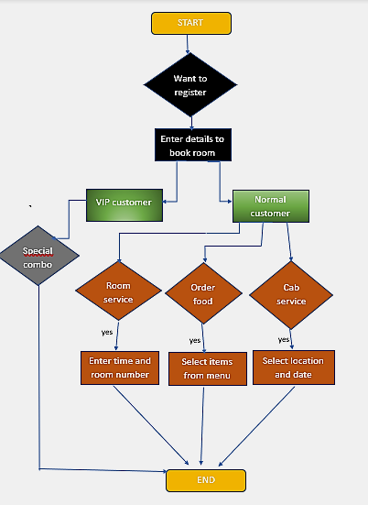
Flow chart

Slide 6

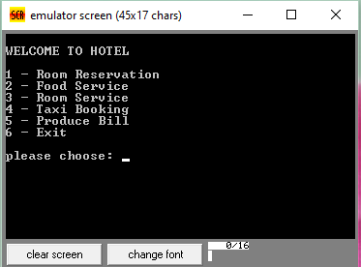
Hotel main menu

Slide 7

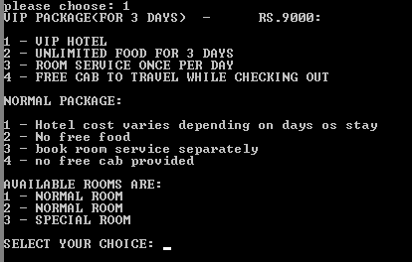
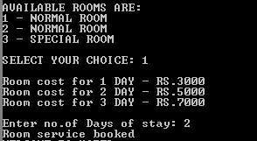
Room booking

Slide 8

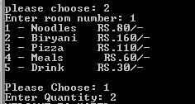
Food service

Slide 9

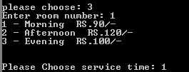
Room service

Slide 10


Taxi booking

Slide 11

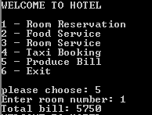
Total bill

Slide 12
THANK
YOU

